Slide 1
Digital Image Processing
*
Advanced Digital Image Processing, Lecturer #6
‹#›

Slide 2
Contents
Background of Segmentation
Color/Intensity Based Segmentation
Region Based Segmentation
Shape Based Segmentation
Motion Based Segmentation
*
Advanced Digital Image Processing, Lecturer #6
‹#›

Slide 3
Background Of Segmentation (1 of 2)
The objective of segmentation is to partition an image into regions based on specific criteria.
Color/Intensity Based Segmentation
Region Based Segmentation
Shape Based Segmentation
Motion Based Segmentation
*
Advanced Digital Image Processing, Lecturer #6
‹#›

Slide 4
Background of Segmentation (2 of 2)
Object point by threshold
Image Histogram
Gray Level Histogram
Single Threshold and Multiple Thresholds
Global, Local and Adaptive Threshold
Region Based Segmentation
Region Growing Methods
Region Splitting and Merging
Segmentation by Morphological Watersheds
*
Advanced Digital Image Processing, Lecturer #6
‹#›

Slide 5
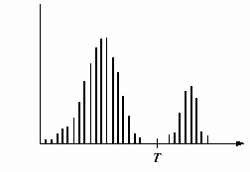
Global Thresholding (1 of 2)
Partition the image histogram by using a single global threshold, T.
Segmentation is then accomplished by scanning the image pixel by pixel and labeling each pixel as object or background, depending on whether the gray level of that pixel is >T or <=T.
Success depends on how well the histogram can be can be partitioned.
Gray Level Histogram
*
Advanced Digital Image Processing, Lecturer #6
‹#›

Slide 6
Global Thresholding (2 of 2) Threshold Selection
Heuristic approach, and
Automatic threshold selection
Select an initial estimate for T
Segment the image using T. Two group G₁ and G₂
Compute the average gray level values μ₁ and μ₂ corresponding to G₁ and G₂
Compute the new threshold T = ½(u₁+ u₂)
Repeat 2-4 until the difference in T in successive iteration is smaller than predefined parameter T₀
*
Advanced Digital Image Processing, Lecturer #6
‹#›

Slide 7
Adaptive Thresholding
Uneven illumination can transform a perfectly segmentable histogram into a histogram that cannot be partition effectively by a single global threshold.
To handle uneven illumination,
Divide the original image into sub-images
Use different threshold to segment each sub-image. Continue this process so that the illumination of each sub-image is approximately uniform.
Threshold for each pixel depend on the point of the pixel in the sub-image.
*
Advanced Digital Image Processing, Lecturer #6
‹#›

Slide 8
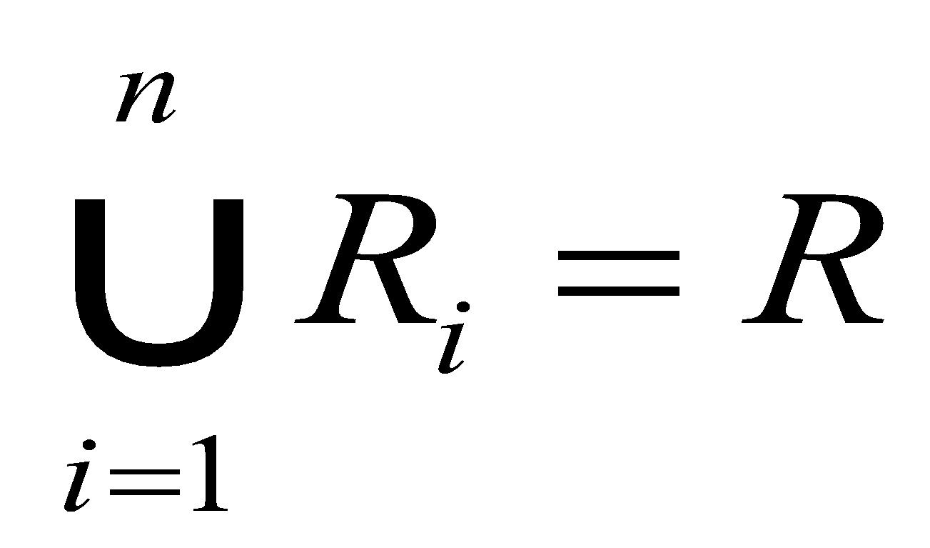
Region Based Segmentation (Basic Formulation)
Let R represent the entire image region and R₁, R₂,…R_{n}, are subregions
(a)
(b) R_{i} is a connected region, i = 1,2,………,n
(c) R_{i} ∩ R_{j} = φ for all i and j, i ≠ j // φ Null set (regions are disjointed)
(d) P(R_{i}) = True, for i = 1,2,……..,n // P(R_{i}) logical predicate defined over the points in set R_{i}, properties satisfied by the pixels in a segmented region.
(e) P(R_{i}UR_{j}) = False for i ≠ j // Two regions are different in the sense of predicate P.// one condition is not valid in other regions
*
Advanced Digital Image Processing, Lecturer #6
‹#›

Slide 9
Region Growing (1 of 2)
Group pixels to sub-regions into a larger regions based on predefined criteria.
Start with a set of “seed” points and from these grow regions by appending to each seed those neighboring pixels that have properties similar to the seed (specific range of gray level or color).
Limitations:
Formulation of Stopping rule
When no more pixels satisfy the criteria growing region should be stopped.
do not consider the history of region growth – size and shape
*
Advanced Digital Image Processing, Lecturer #6
‹#›

Slide 10
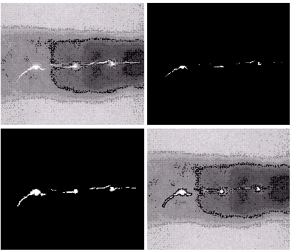
Region Growing (2 of 2)
Seed points gray value=255
Difference between seed point with other points gray level is less than 65
Find connected region that satisfies same condition
a, b
c, d
a) Defective welds, b) Seed points c) Result of region growing, d) Boundaries of segmented defective welds
*
Advanced Digital Image Processing, Lecturer #6
‹#›

Slide 11
Region Splitting and Merging (1 of 2)
Partition the image into numbers of quadrant regions
R
R₁
R₂
R₁
R₂
R₃
R₄
R₄₁
R₄₂
R₃
R₄₃
R₄₄
R₄₁
R₄₂
R₄₃
R₄₄
Partition image
Quadtree
*
Advanced Digital Image Processing, Lecturer #6
‹#›

Slide 12
Region Splitting and Merging (2 of 2)
Split into four disjoint quadrants any region R_{i} for which P(R_{i})=False.
Merge any adjacent regions Rj and Rk for which P(R_{j}UR_{k})=True
Stop when no further merging or splitting is possible
*
Advanced Digital Image Processing, Lecturer #6
‹#›

Slide 13
Morphological Watershed (1 of 4)
The concept of watersheds is based on visualizing an image in three dimension: two coordinates versus gray levels. To explain this we consider 3 points:
Points belonging to a regional minimum;
Points at which a drop of water, if placed at the location of any of those points, would fall with certainly to a single minimum; (such points called catchment basin or watershed of that minimum)
Points at which water would be equally likely to fall to more than one such minimum (Watershade lines)
*
Advanced Digital Image Processing, Lecturer #6
‹#›

Slide 14
Morphological Watershed (2 of 4)
Find the watershed lines:
Punch a hole in each regional minimum
Flood the entire topography from below by letting water rise through the holes at a uniform rate.
When the rising water in distinct catchment basin is about to merge, build dams to prevent catchment basin from merging
Once fully flooded, only the top of the dams are remained.
These dams (closed) boundaries corresponding to the divide lines of the watersheds.
*
Advanced Digital Image Processing, Lecturer #6
‹#›

Slide 15
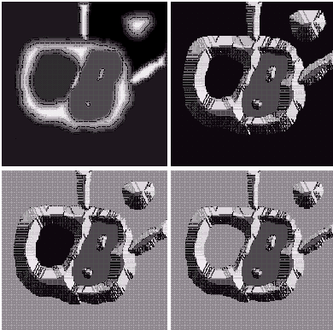
Morphological Watershed (3 of 4)
A
B
(A) = Original Image
(B) = Topographic view
(C), (D) = Two stages of flooding
C
D
*
Advanced Digital Image Processing, Lecturer #6
‹#›

Slide 16
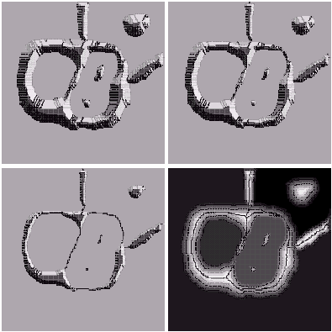
Morphological Watershed (4 of 4)
E
F
E. Result of Further Flooding
F. Beginning of Merging of Water from two catchment basin
G. Longer Dams
H. Watershed (segmentation lines)
G
H
*
Advanced Digital Image Processing, Lecturer #6
‹#›

Slide 17
Motion Based Segmentation
Background subtraction from each image frame: when camera and background is fixed
M_{i}=X_{t}-B (B=background image)
Subtraction two successive image frames: if camera or background or both is moving.
M_{i}=X_{t}-X_{t+1}
*
Advanced Digital Image Processing, Lecturer #6
‹#›

Slide 18
List of Reference Books
Rafael C. Gonzalez, “Digital Image Processing”.
Anil K. Jain, “Fundamental of Digital Image Processing”.
Dana H. Ballard, “Computer Vision”
David H. Hubel, “Eye, Brain, and Vision”
Dwayne Phillips, “Image Processing in C”
*
Advanced Digital Image Processing, Lecturer #6
‹#›

Slide 19
End of Today’s Lecture
Questions and Suggestions?
Thanks to all!
*
Advanced Digital Image Processing, Lecturer #6
‹#›

